Slide 1

Mobile Application Development
Welcome
Class: BS(CS)-VII
Sukkur IBA University – Kandhkot Campus
Week - 05
Lecture – 09
Your Facilitator, Adil Khan

Slide 2
Intent

Slide 3
Explicit vs. implicit Intent
Explicit Intent — Starts an Activity of a specific class
Implicit Intent — Asks system to find an Activity class with a registered handler that can handle this request

Slide 4
Explicit Intent
Android Explicit intent specifies the component to be invoked from activity.
In other words, we can call another activity in android by explicit intent.
We can also pass the information from one activity to another using explicit intent.
Here, we are going to see an example to call one activity from another and vice-versa.

Slide 5
Android calling one activity from another activity example
MainActivity1.java
Intent i = new Intent(getApplicationContext(), SecondActivity.class);
i.putExtra("Value1", "Android By Javatpoint");
i.putExtra("Value2", "Simple Tutorial");
// Set the request code to any code you like, you can identify the
// callback via this code
startActivity(i);

Slide 6
Android calling one activity from another activity example
MainActivity2.java
Bundle extras = getIntent().getExtras();
String value1 = extras.getString("Value1");
String value2 = extras.getString("Value2");
Toast.makeText(getApplicationContext(),"Values are:\n First value: "+value1+ "\n Second Value: "+value2, Toast.LENGTH_LONG).show();

Slide 7
Android calling one activity from another activity example
MainActivity2.java
Intent i = new Intent(getApplicationContext(), FirstActivity.class);
startActivity(i);

Slide 8
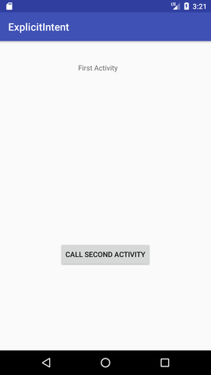
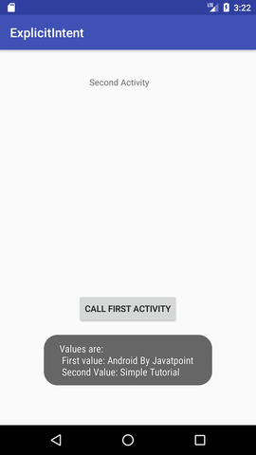

Android calling one activity from another activity example

Slide 9
Implicit Intent
Implicit intent is used to start an Activity in another app by describing an action you intend to perform, such as "share an article", "view a map", or "take a picture“
You don't specify the exact activity (or other component) to run—instead, you include just enough information in the intent about the task you want to perform.
Specify an action and optionally provide data with which to perform the action
URL to open, location on map etc.

Slide 10
Implicit Intent
The Android system matches the information in your request intent with any activity available on the device that can perform that task.
If there's only one activity that matches, that activity is launched.
If more than one activity matches the intent, the user is presented with an app chooser and picks which app they would like to perform the task.

Slide 11
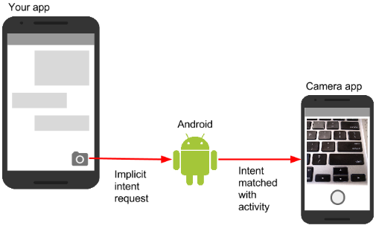
Implicit Intent

Slide 12
Implicit Intent
For example, you have an app that lists available snippets of video. If the user touches an item in the list, you want to play that video snippet.
Rather than implementing an entire video player in your own app, you can launch an Intent that specifies the task as "play an object of type video." The Android system then matches your request with an Activity that has registered itself to play objects of type video.

Slide 13
Implicit Intent
An Activity registers itself with the system as being able to handle an implicit Intent with Intent filters, declared in the AndroidManifest.xml file.
For example, the main Activity (and only the main Activity) for your app has an Intent filter that declares it the main Activity for the launcher category.
This Intent filter is how the Android system knows to start that specific Activity in your app when the user taps the icon for your app on the device home screen.

Slide 14
Implicit Intent actions, categories, and data
An implicit Intent, like an explicit Intent, is an instance of the Intent class.
In addition to the parts of an Intent you learned about in an earlier chapter (such as the Intent data and extras), these fields are used by an implicit Intent:
Intent action
Intent category
Data type

Slide 15
Intent action
The Intent action is the generic action the receiving Activity should perform.
The available Intent actions are defined as constants in the Intent class and begin with the word ACTION_.
A common Intent action is ACTION_VIEW, which you use when you have some information that an Activity can show to the user, such as a photo to view in a gallery app, or an address to view in a map app.
You can specify the action for an Intent in the Intent constructor, or with the setAction() method.

Slide 16
Intent category
An Intent category provides additional information about the category of component that should handle the Intent.
Intent categories are optional, and you can add more than one category to an Intent.
Intent categories are also defined as constants in the Intent class and begin with the word CATEGORY_. You can add categories to the Intent with the addCategory() method.

Slide 17
Data type
The data type indicates the type of data the Activity should operate on.
Usually, the data type is inferred from the URI in the Intent data field, but you can also explicitly define the data type with the setType() method.

Slide 18
Implicit Intent
Intent actions, categories, and data types are used both by the Intent object you create in your sending Activity, as well as in the Intent filters you define in the AndroidManifest.xml file for the receiving Activity.
The Android system uses this information to match an implicit Intent request with an Activity or other component that can handle that Intent.

Slide 19
How does implicit Intent work?
The Android Runtime keeps a list of registered Apps
Apps have to register via AndroidManifest.xml
Runtime receives the request and looks for matches
Android runtime uses Intent filters for matching
If more than one match, shows a list of possible matches and lets the user choose one
Android runtime starts the requested activity

Slide 20
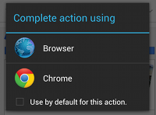
How does implicit Intent work?
When the Android runtime finds multiple registered activities that can handle an implicit Intent, it displays an App Chooser to allow the user to select the handler

Slide 21
Sending an Implicit Intent
Starting an Activity with an implicit Intent, and passing data from one Activity to another, works much the same way as it does for an explicit Intent:
In the sending Activity, create a new Intent object.
Add information about the request to the Intent object, such as data or extras.
Send the Intent with startActivity() (to just start the Activity) or startActivityforResult() (to start the Activity and expect a result back).

Slide 22
Sending an Implicit Intent
When you create an implicit Intent object, you:
Do not specify the specific Activity or other component to launch.
Add an Intent action or Intent categories (or both).
Resolve the Intent with the system before calling startActivity() or startActivityforResult().
Show an app chooser for the request (optional).

Slide 23
Sending an Implicit Intent
Resolve the Activity before starting it
When you define an implicit Intent with a specific action and/or category, there is a possibility that there won't be any Activity on the device that can handle your request.
If you just send the Intent and there is no appropriate match, your app will crash.

Slide 24

Sending an Implicit Intent
Resolve the Activity before starting it
To verify that an Activity or other component is available to receive your Intent, use the resolveActivity() method with the system package manager like this:

Slide 25
Sending an Implicit Intent
Resolve the Activity before starting it
If the result of resolveActivity() is not null, then there is at least one app available that can handle the Intent, and it's safe to call startActivity(). Do not send the Intent if the result is null.
If you have a feature that depends on an external Activity that may or may not be available on the device, a best practice is to test for the availability of that external Activity before the user tries to use it.
If there is no Activity that can handle your request (that is, resolveActivity() returns null), disable the feature or provide the user an error message for that feature.

Slide 26
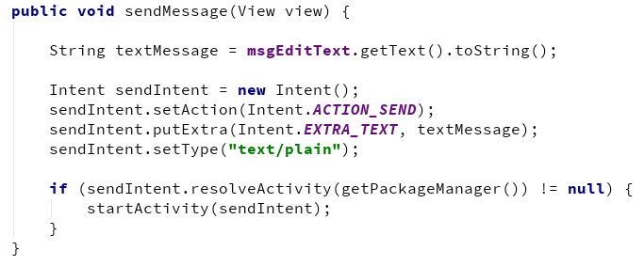
Sending an Implicit Intent

Slide 27
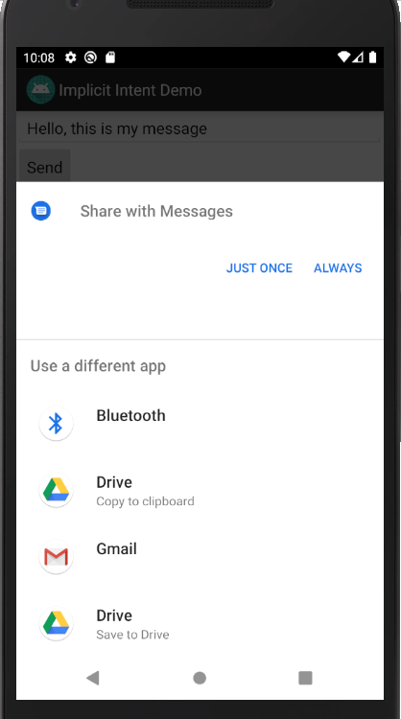
Sending an Implicit Intent

Slide 28
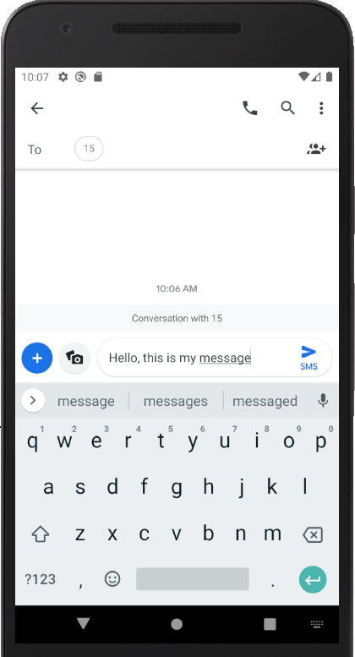
Sending an Implicit Intent

Slide 29
Sending an Implicit Intent
Show the app chooser
In many cases the user has a preferred app for a given task, and they will select the option to always use that app for that task.
However, if multiple apps can respond to the Intent and the user might want to use a different app each time, you can choose to explicitly show a chooser dialog every time.
For example, when your app performs a "share this" action with the ACTION_SEND action, users may want to share using a different app depending on the current situation.

Slide 30
Sending an Implicit Intent
Show the app chooser
To show the chooser, you create a wrapper Intent for your implicit Intent with the createChooser() method, and then resolve and call startActivity() with that wrapper Intent.
The createChooser() method also requires a string argument for the title that appears on the chooser. You can specify the title with a string resource as you would any other string.

Slide 31
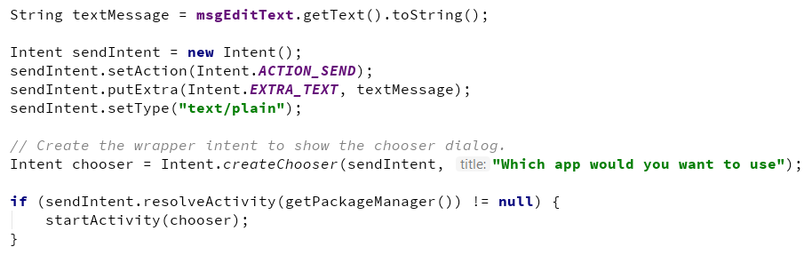
Sending an Implicit Intent
Show the app chooser

Slide 32
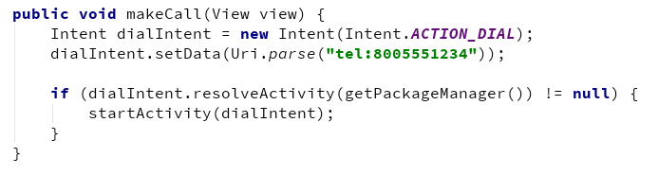
Sending an Implicit Intent

Slide 33
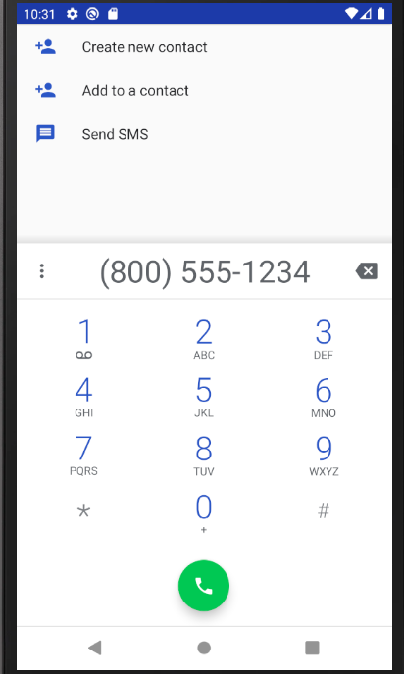
Sending an Implicit Intent

Slide 34
Sending an Implicit Intent – More examples
Show a web page Uri uri = Uri.parse("http://www.google.com"); Intent it = new Intent(Intent.ACTION_VIEW,uri); startActivity(it);
Dial a phone number Uri uri = Uri.parse("tel:8005551234");
Intent it = new Intent(Intent.ACTION_DIAL, uri);
startActivity(it);

Slide 35
Sending an Implicit Intent – More examples
1. Create an Intent for an action
Intent intent = new Intent(Intent.ACTION_WEB_SEARCH);
2. Put extras
String query = edittext.getText().toString();
intent.putExtra(SearchManager.QUERY, query));
3. Start the Activity
if (intent.resolveActivity(getPackageManager()) != null){ startActivity(intent); }

Slide 36
Receiving an Implicit Intent
If you want an Activity in your app to respond to an implicit Intent (from your own app or other apps), declare one or more Intent filters in the AndroidManifest.xml file.
Each Intent filter specifies the type of Intent it accepts based on the action, data, and category for the Intent.
The system will deliver an implicit Intent to your app component only if that Intent can pass through one of your Intent filters.

Slide 37
Register your app to receive an Intent
Declare one or more Intent filters for the Activity in AndroidManifest.xml
Filter announces ability of Activity to accept an implicit Intent
Filter puts conditions on the Intent that the Activity accepts

Slide 38
Register your app to receive an Intent
Once your Activity is successfully launched with an implicit Intent, you can handle that Intent and its data the same way you did an explicit Intent, by:
Getting the Intent object with getIntent().
Getting Intent data or extras out of that Intent.
Performing the task the Intent requested.
Returning data to the calling Activity with another Intent, if needed.

Slide 39
Intent filters
Define Intent filters with one or more <intent-filter> elements in the AndroidManifest.xml file, nested in the corresponding <activity> element.
Inside <intent-filter>, specify the type of intent your activity can handle.
The Android system matches an implicit intent with an activity or other app component only if the fields in the Intent object match the Intent filters for that component.

Slide 40
Intent filters
An Intent filter may contain the following elements, which correspond to the fields in the Intent object described above:
<action>: The Intent action that the activity accepts.
<data>: The type of data accepted, including the MIME type or other attributes of the data URI (such as scheme, host, port, and path).
<category>: The Intent category.

Slide 41
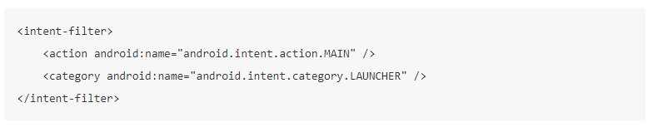
Intent filters
For example, the main Activity for your app includes this <intent-filter> element

Slide 42
Intent filters
This Intent filter has the action MAIN and the category LAUNCHER. The <action> element specifies that this is the app's "main" entry point.
The <category> element specifies that this activity should be listed in the system's app launcher (to allow users to launch the activity). Only the main activity for your app should have this Intent filter.

Slide 43
Intent filter in AndroidManifest.xml
<activity android:name="ShareActivity"> <intent-filter> <action android:name="android.intent.action.SEND"/> <category android:name="android.intent.category.DEFAULT"/> <data android:mimeType="text/plain"/> </intent-filter>
</activity>

Slide 44
Intent filters: action and category
action — Match one or more action constants
android.intent.action.VIEW — matches any Intent with ACTION_VIEW
android.intent.action.SEND — matches any Intent with ACTION_SEND
category — additional information
android.intent.category.BROWSABLE— can be started by web browser
android.intent.category.LAUNCHER— Show activity as launcher icon

Slide 45
Intent filters: data
data — Filter on data URIs, MIME type
android:mimeType="text/plain" — limit the acceptable types of documents

Slide 46
Thank you!
Any Questions???

